Slide 1


Analysis of STEAM DATA
STEAM
By :- Sumit Bhagat

Slide 2



Introduction
This project is on steam data analysis. It mainly focuses on analyzing the factors like Title, Price, Original_price, Discount, Release_discount, Platforms, Review_count
About Steam
Steam is the world’s largest digital distribution platform for PC gaming, created by Valve Corporation. It was launched in 2003 as a way to deliver game updates, but has grown into a full ecosystem for buying, downloading, and playing games.

Slide 3


Business Problems:
High Competition & Revenue Split – Steam faces tough competition from Epic Games Store and others, and developers criticize its 30% revenue cut.
Overcrowded Marketplace – Too many games launch every month, making discoverability difficult for indie developers.
Refund Abuse & Regional Price Exploits – Some users exploit refund policies or use VPNs to buy games cheaper, hurting developer profits.
Objectives of the project:
Grow Market Share & Revenue – Stay the leading PC gaming platform and attract more developers and users.
Improve User & Developer Experience – Better recommendations, tools, and support to make games more discoverable.
Expand Ecosystem Globally – Support new regions, currencies, and devices (like Steam Deck) to reach more players worldwide.

Slide 4
Web Scraping:
Web scraping is a way to automatically collect the data from websites. By the help of the Requests and the Beautiful Soup.
Instead of copying the information by hand, you use code (often in Python) to grab the data like prices, product details, or reviews from the web pages.
The scraper sends a request to the website, reads the HTML content, and pulls out the parts you need—then saves it in a clean format like a spreadsheet or in the form of the Data Frame.
It’s useful for the market trends or research, price tracking, lead generation, and many more.

Slide 5
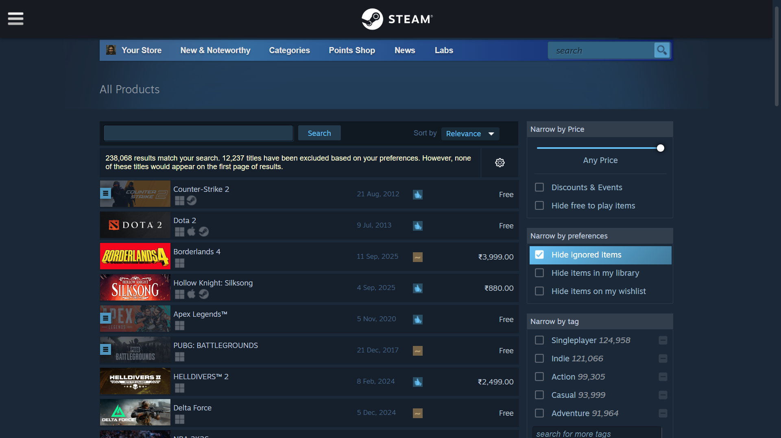
Interface of the website:

Slide 6
Extracting the Data From the Containers:
Extracted the details from the container like Title, Price, Original_price, Discount, Release_discount, Platforms, Review_count.

Slide 7
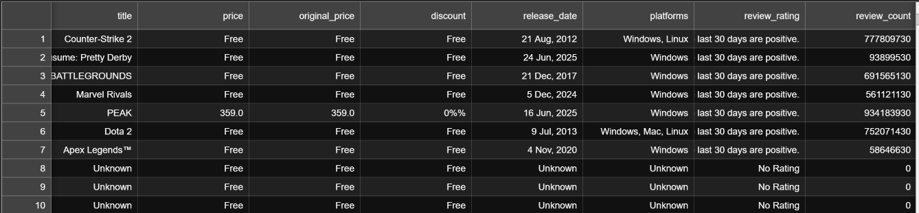
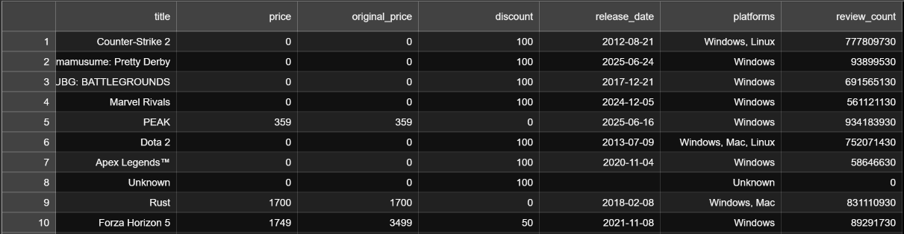
Data Cleaning:
The original data frame was not cleaned, so I performed several data cleaning operations on it.
This included removing unnecessary columns and characters, handling missing values, and converting columns to appropriate data types to ensure the consistency.
OLD
NEW

Slide 8
Data Visualization:
The Data Visualization is the art of turning the raw data into visual formats—like the charts and the graphs—to make the patterns, trends, and insights easier to understand and communicate that’s why we use the visualizations.
There are 3 types of Data Visualization techniques that are :-
Univariate Analysis.
Bivariate Analysis.
Multivariate Analysis.

Slide 9
Visualization Techniques
Univariate Analysis: This looks at one column at a time. It tells us how the data is spread out, its average (mean, median, mode), and how much it varies (range, standard deviation). It’s usually the first step when we start exploring a dataset.
Bivariate Analysis: This looks at two columns at a time. It helps us see if they are connected — for example, if one goes up, does the other go up (positive relation), go down (negative relation), or stay the same (no relation). It shows us patterns and trends between two things.
Multivariate Analysis: This looks at more than two columns at once. It helps find hidden patterns and shows how many factors together can affect the result.

Slide 10
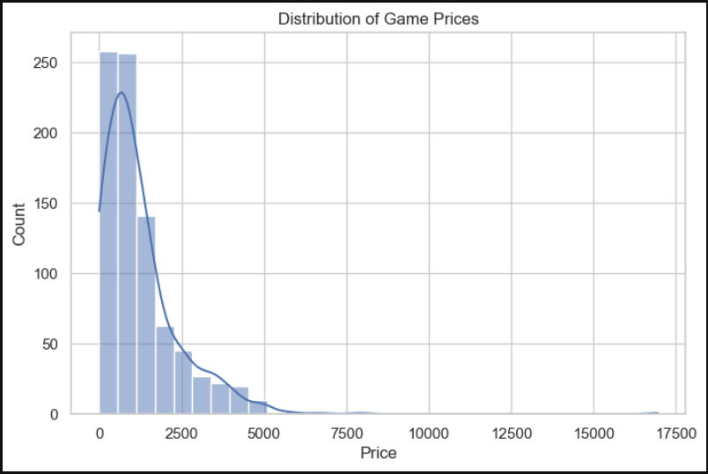


Numerical Column
UNIVARIATE VISUALIZATION
Distribution Of Game Price.
Observation
1. Most games are either free or very low-priced.
2. Only a handful of titles are expensive, which creates a right-skewed distribution.

Slide 11
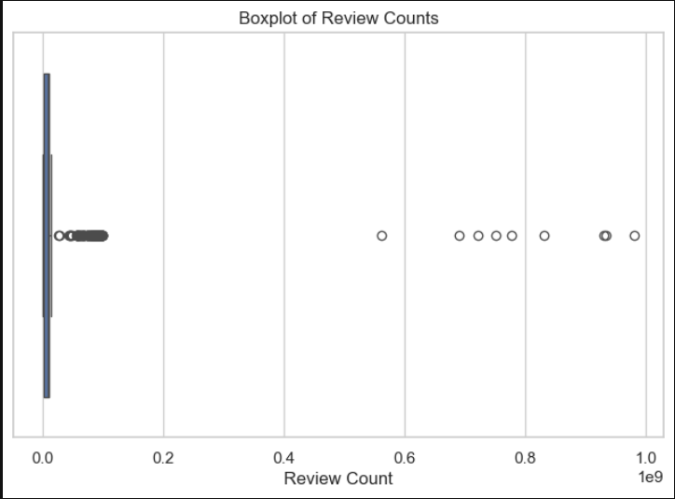

Boxplot of Review Counts.
Observation:
1. A few blockbuster games have extremely high review counts.
2. The majority of games lie at the lower end, indicating most titles don’t get massive attention.

Slide 12
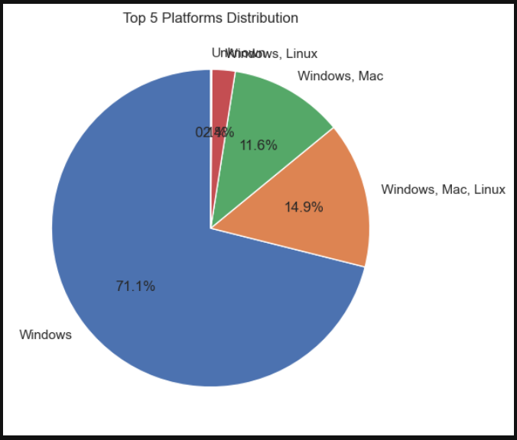

Pie Chart of Top 3 Platforms.
Observation:
1. The Windows platform dominates game availability.
2. Linux and others have a very small share, making Steam heavily PC-focused.

Slide 13

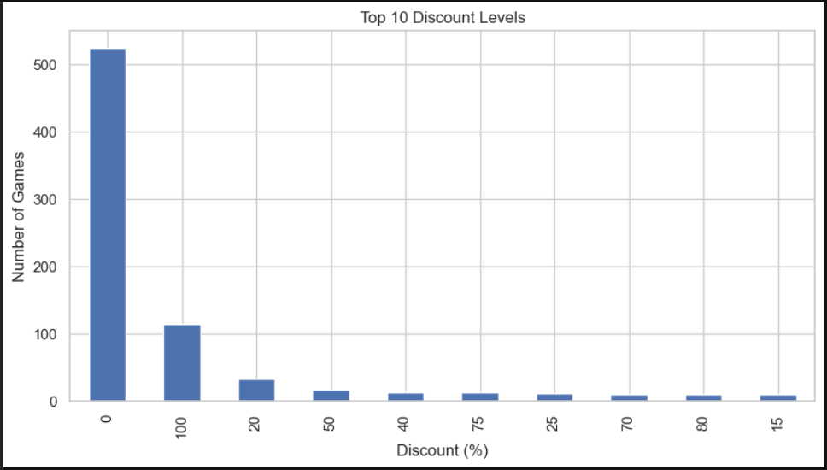
Categorical
Column
Bar Chart of Top 10 Discount Levels.
Observation:
1. The most frequent discount is 100% (free-to-play).
2. Other common discount levels are round figures like 50% and 75%.

Slide 14

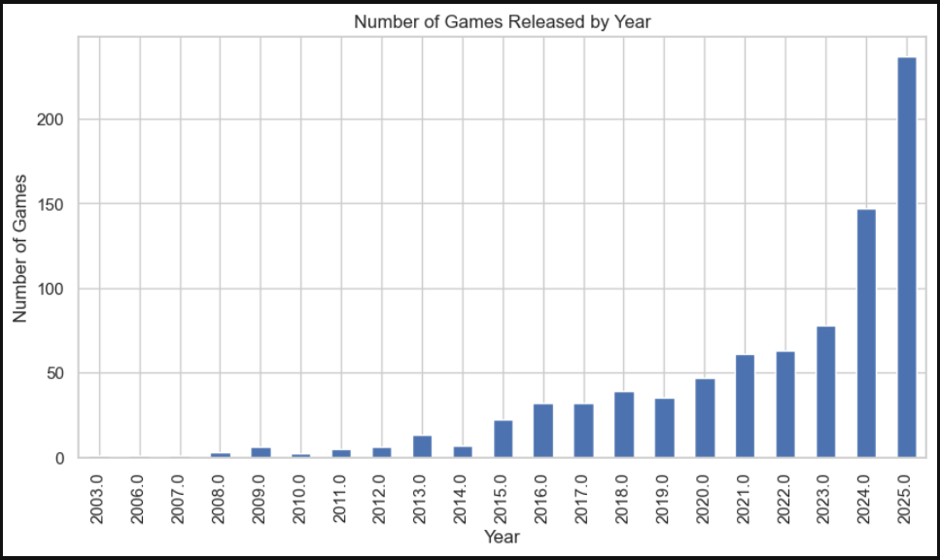
Bar Plot of Release Year.
Observation:
1. Game releases spike in recent years. Steam’s catalog has grown rapidly in the last decade, showing an expansion in PC gaming.

Slide 15
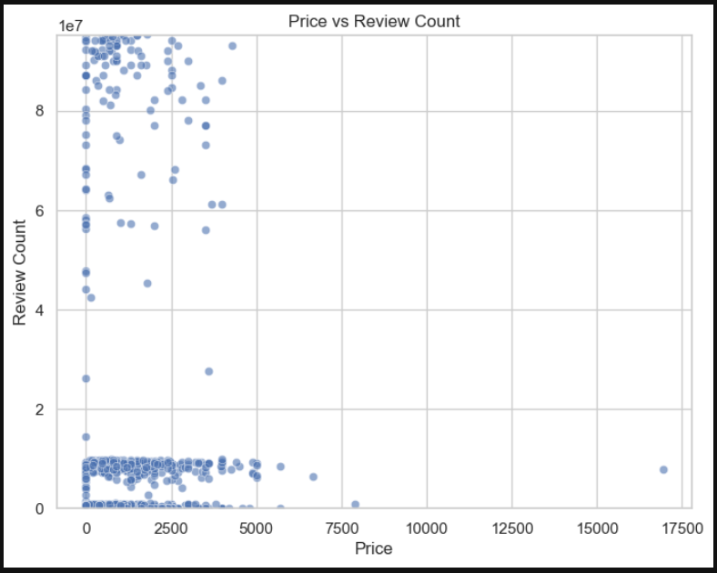

BIVARIATE VISUALIZATION
1. Scatter Plot: Price vs Review Count.
Observation:
1. Popular games with high review counts are mostly free or low-priced.
2. Expensive games generally attract fewer reviews.

Slide 16

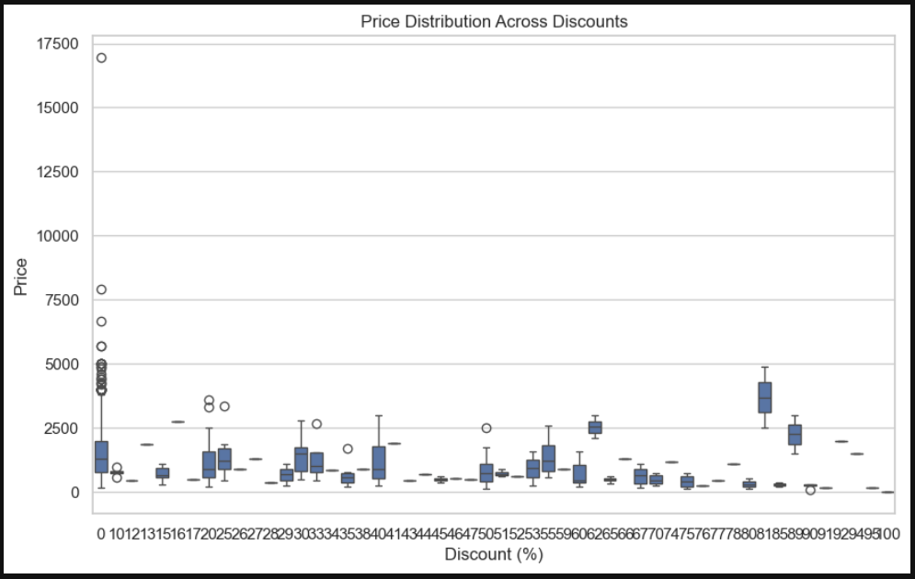
Boxplot: Discount vs Price.
Observation:
1. Higher discounts are usually applied to higher-priced games.
2. Games that are free naturally appear at the 100% discount level.

Slide 17

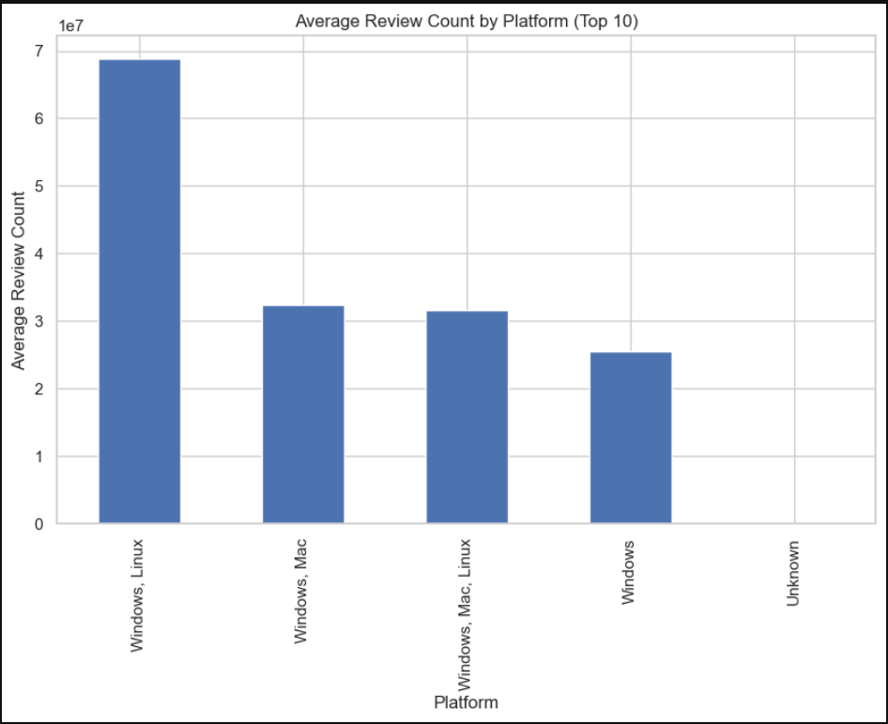
Bar Chart: Average Review Count by Platform.
Observation:
1. Windows games have the highest average reviews.
2. other platforms show much smaller engagement, suggesting players mainly stick to Windows.

Slide 18
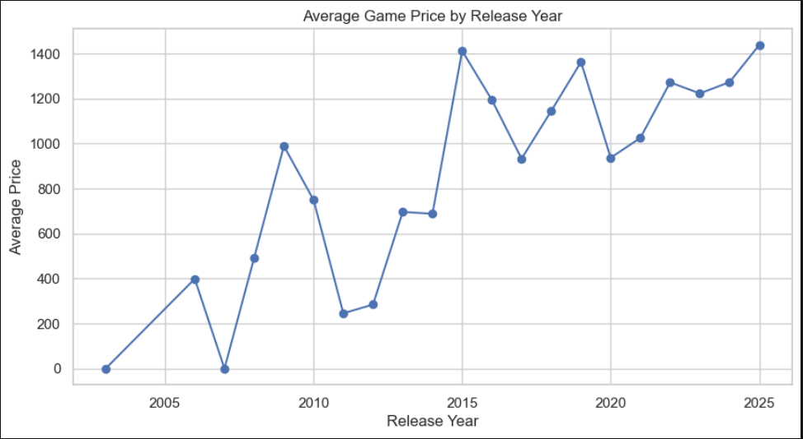

Line Plot of Avg Price by Release Year.
Observation:
1. Prices fluctuate over time. Older releases tend to be cheaper (probably due to discounts), while new releases initially appear at higher prices.

Slide 19
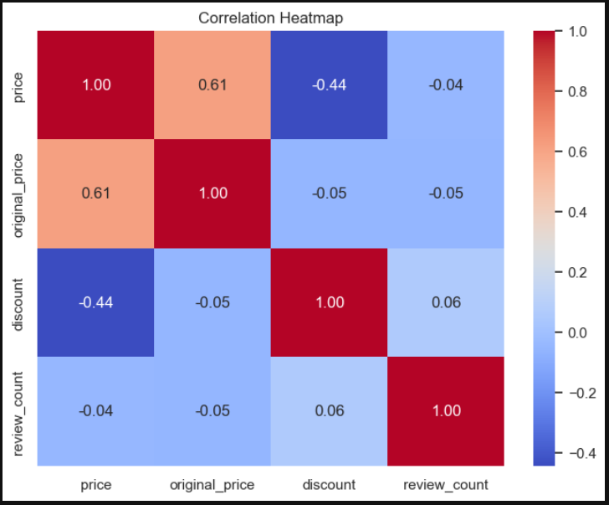

MULTIVARIATE VISUALIZATION
Heatmap of Correlation.
Observation:
1. price and original_price are strongly positively correlated (as expected).
2. discount is negatively correlated with price, showing higher discounts reduce final price.
3. review_count doesn’t correlate strongly with price, meaning popularity isn’t tied to cost.

Slide 20
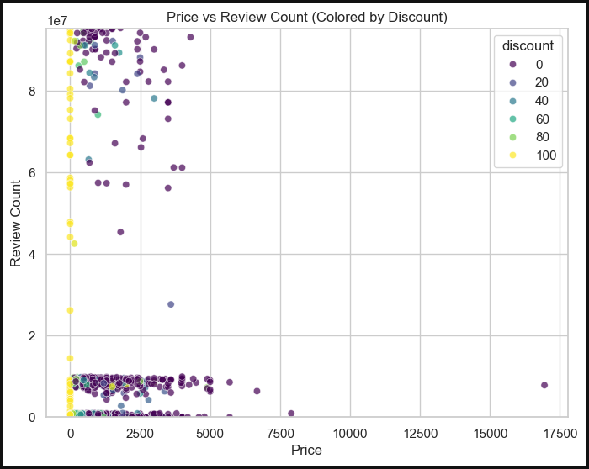

Scatter Plot (Price vs Reviews colored by Discount)
Observation:
1. Games with 0% discount tend to spread across all price ranges.
2. Free or highly discounted games tend to have higher reviews, reinforcing the idea that lower cost boosts engagement.

Slide 21
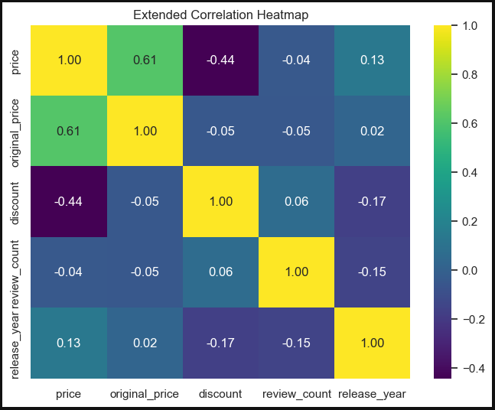

Heatmap of Reviews, Price, and Year
Observation:
1. Release year has weak correlation with pricing and reviews. Price–discount–original price 2. remain the strongest relationships.

Slide 22
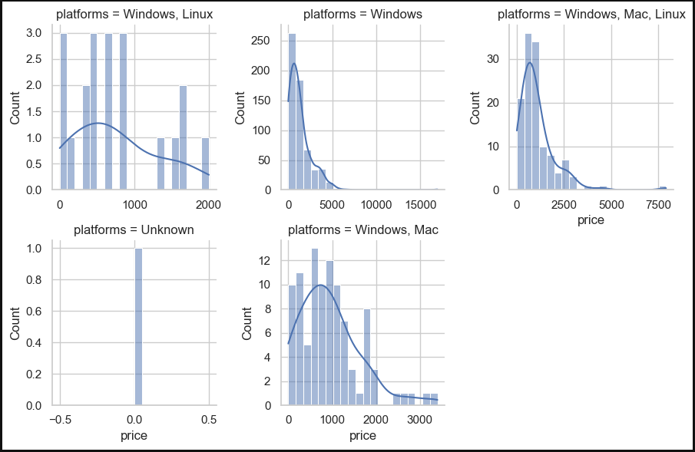

Facet Grid of Price Distribution by Platform
Observation:
1. Windows has the widest price range. Other platforms show limited distribution, often clustering at free/cheap games.

Slide 23

Conclusion
Most Steam games are free or low-priced, and Windows is the main platform players use. Higher discounts usually lead to more players and reviews, while expensive games get fewer reviews. Game releases have increased in the last few years, showing the rapid growth of PC gaming. This analysis helps understand how price, discounts, and platforms affect player engagement and sales.

Slide 24


Thank You…

